Slide 1
The Sacraments of Penance & Baptism
The central law that governs every Western Law court case
Disclaimer: Roger Isaacs has received approval from Frank O’Collins to share Ucadia material for information and learning purposes only. This presentation is not to be considered legal advice nor is it to be shared beyond the TPC Law Group. Ucadia material is copyrighted in trust and cannot be used for commercial purposes, sold or used to generate income. By joining the TPC Law Group you have consented to these terms.

Slide 2

Why Is This Important?
We must separate the Tyrant from the Law so they can no longer hide behind the Law.
They do not represent the True Law and we need to expose them as criminals.
This is the first time in at least 1,000 years they have had to deal with competent people

Slide 3
Topics We Will Cover
What is a Sacrament
Sin, Grace, Penance, Salvation
Sacrament of Baptism
Sacrament of Penance
What is a Court & What’s Going On

Slide 4
Sacrament

Slide 5
What Is a Sacrament
A valid Sacrament is an important sacred rite, also known as a ritual, instituted by the authority of the Divine Creator, through which certain divine property or action is properly conveyed or effected in the presence of the manifest spiritual.
All valid sacraments were instituted by the Divine Creator. Any claimed sacrament that is granted through the authority of false claims of Divine Right is a false ritual and possesses no Divine authority or power to be known as a valid sacrament.
Sacraments are a vital and necessary element of a fulfilled and purposeful life, assisting each and every self-reasoning being, living and deceased to reach their full potential and communion with the Divine Creator, the Universe and with one another.
A Sacrament conferred from false claims of Divine Right has no effect of law and is invalid ab initio (from the beginning)

Slide 6
Sin, Grace,
Salvation, Penance

Slide 7

What is Sin
Original Sin is one of the most important concepts for control of the world
Bankruptcy implies the spiritual, mental and physical insolvency of people.
The deliberate cheating, deception & theft of Rights and Property against the Rule of Law
The concept of Original Sin as designed by the lawyers of the Vatican means:
All people are born bankrupt and in debt
Automatically without traditional Rights.
They are "lawfully" slaves until this debt is settled.
By granting the Vatican the right to salvage and then monetize these debts in the form of money:
Individuals are then freed from debt
Granted minimal rights under the control of the Vatican (which controls the energy of the world.)
Sin is unique as a fictional concept within the fictional framework of Morality:
Unlike general offences, the offence of sin is claimed to be inheritable, such as the form called “Original Sin”.
Formed as an essential commercial element of the control of the Vatican from the 16th C
Includes its associated opposite concepts of Grace and Salvation.
Original Sin is essential to justify the concept of the need to "salvage" the souls of people through "Grace" to the Vatican
Maxim of Law: No one is punished for a transgression of an ancestor or another

Slide 8

What is Salvation
Salvation (16th C): Latin root “salvus” meaning "to make safe and secure possession without violating (the law)".
The "salvation of the soul" is the claimed securing possession of the soul without violating Divine Law
Salvation is deliberately and falsely compared to the concept of Redemption, whereby:
A person is capable of reforming previous behaviour or character
Salvation depends upon the promotion of the concept of Original Sin
Itis a commercial Claim of Right dressed up as a religious dogma.
The receipt of goods and payment received by the Vatican for “Salvaging Souls” under the dogma of Salvation is:
The right to control the monetization of Sin
The essential concept underpinning debt and
almost all money systems of the world today.
Salvation is the dogma and concept first introduced by the Vatican in the 16th C that:
As all people are born with “original sin” and therefore “lost”
God has granted the Vatican the exclusive right to "salvage the souls" through the sacraments of Baptism and Penance.
“Salvation” is the “lawful” receipt and payment to the Vatican for the salvage and recovery of lost property.
In the case of Baptism, it is also known as the "Salvation of Treasure".
Maxim of Law: All possess the Right over their divine self that none may claim our soul

Slide 9

What is Grace
Grace: means a cheerful disposition to simplicity and poverty; hence, the word comes from the Latin “gracilis” meaning ”slight, meager and poor”.
In order to promote a system of deprivation of rights and slavery, the Vatican devised the concept whereby:
Christian followers would be told that if they accepted their lot in life and the authority of the church, then God would grant them an undeserved state of “peace, tranquility and inner joy” called Grace
That through Salvation (salvage) they will enter Heaven.
Thus Grace has been a powerful mind tool in promoting voluntary servitude, also known as slavery
Grace, or Divine Grace is a dogma first introduced by the Vatican in the 14th Century that:
Assigns Grace as an attribute of God
Bestows undeserved and overflowing love and mercy to those willing to be salvaged through Salvation of the Vatican
The success of the concept of Grace in voluntarily accepting that being poor and deprived is “ordained by God” has seen it extended as a concept across almost all religions and political systems interested in maintaining status quo and control.
There is no Divine Law that says the Divine Creator wishes a person to remain in servitude and poverty, nor another to remain in lordship and control; therefore, the concept of Grace is false

Slide 10
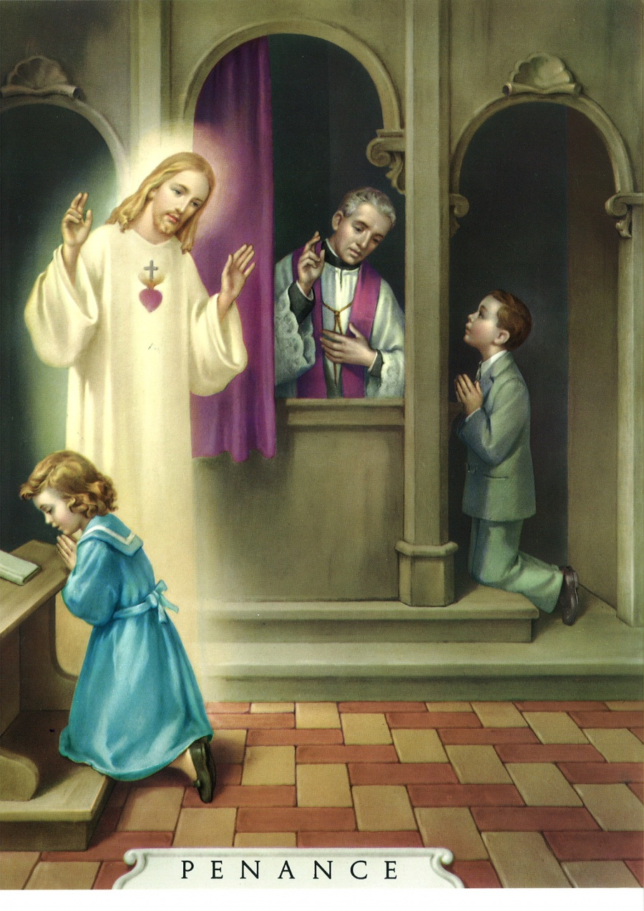
What is Penance
Penance: 14th C meaning derived from the ancient Latin word “poena” meaning “punishment (for a crime)”.
Penance is a dogma first introduced by the Vatican in the 14th C whereby a person:
Willingly and knowingly consents to punishment, sometimes even self-punishment….
as repentance and atonement for some sin..
after their willing confession that lawfully converts their sins into to a crime and an unrecorded or recorded criminal conviction…
In Western Law, sin and crime are considered interchangeable and equivalent terms.
Why the false dogma of original sin converts all people into debt slaves and criminals under the control of the Vatican:
The ancient principle of requiring an oath or vow as a valid contract may be absent.
Consequently, in seeking to remain technically in honor with the ancient principles of law, the Vatican devised the concept of Penance so that people confess their crimes as sins
A legal contract then exists for inflicting some form of punishment such as death, torture or taking of property.
The Vatican claims god in his infinite grace draws down from the credits in the Treasury of One Heaven to offset our sins (debt). With no comparable event on earth,, they invented concepts & rituals to commoditize and forgive sin (debt) in the temporal world

Slide 11
The Sacrament of
Baptism

Slide 12
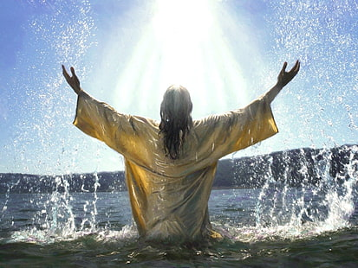
Origin of Baptism – A Christian Doctrine Since 314 CE
In the ancient world all water was seen as the bringer of life, hence all water was considered sacred, hence “holy water”. As the physical body is 75% water, no man or woman could ever be declared unsacred
From Ancient Greek “Baptizmos”
Bapto: I dip, I immerse
-izmos: suffix that forms abstract nouns of action, state, condition, doctrine
The true Christian sacrament of “Baptizmos”:
Explicitly forbid any notion such as original sin, imperfection, blemish, curse, slavery or bondage and
Any claim a child could be born inheriting the crimes and debts of the parents was considered an absurdity and abomination
In 1537 the Vatican, the false Roman Catholic Church, instituted a corruption of the Baptismal ceremony whereby:
The ritual represented the conveyance of the soul of the child as property to the church in trust as a “deposit of faith”.
Since 1933, this 3rd Cestui Que Vie Trust is used to justify that persons baptized no longer “own” their own soul and
May be legally classed as things under Maritime Law
Anyone leading the false ceremony of Baptism as a simulated act of salvation of the spirit, or falsely declaring an infant that is alive to be dead, or the curse of original sin, blemish, enslavement is complicit and culpable of a grave transgression against Christianity, the laws of the Universe and the Divine Creator, and have no force or effect from the beginning

Slide 13
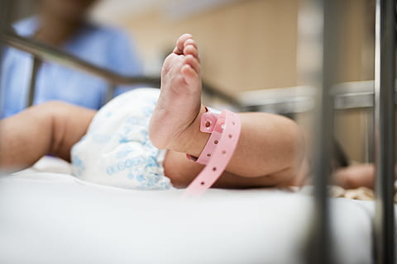
Why is a Baby Baptized?
The concept of infant baptism was started by the Jesuits in the 16th C.
Baptism was never meant for babies prior to that, babies cannot give consent, only an adult can give consent.
Baptism is a gateway sacrament necessary for the salvation (salvage)
Validly conferred by washing with water and the proper form of words.
Through baptism, men and women are freed (salvaged from sin)
Are reborn (reborn is to die first) as children of God and configured to Christ by indelible character
Are incorporated to the Church.
Configured means something replaces that, a body is created and incorporated
Meaning of Baptismo
Ba: Soul (Egyptian)
Apto: Prepare, fit
Is: for
Mo: Moloch (Satan)
Ba-apto-is-mo:
To prepare the soul for moloch (satan)
Their ultimate source of power is their ultimate Achille’s heel, for a law without remedy and an act done through trickery and deceit, is a fraud, and fraud negates all claims and subsequent actions

Slide 14
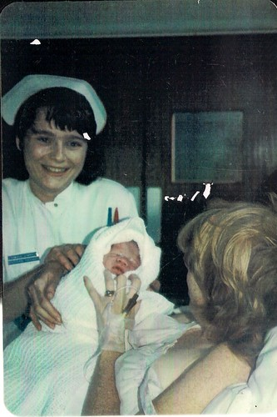
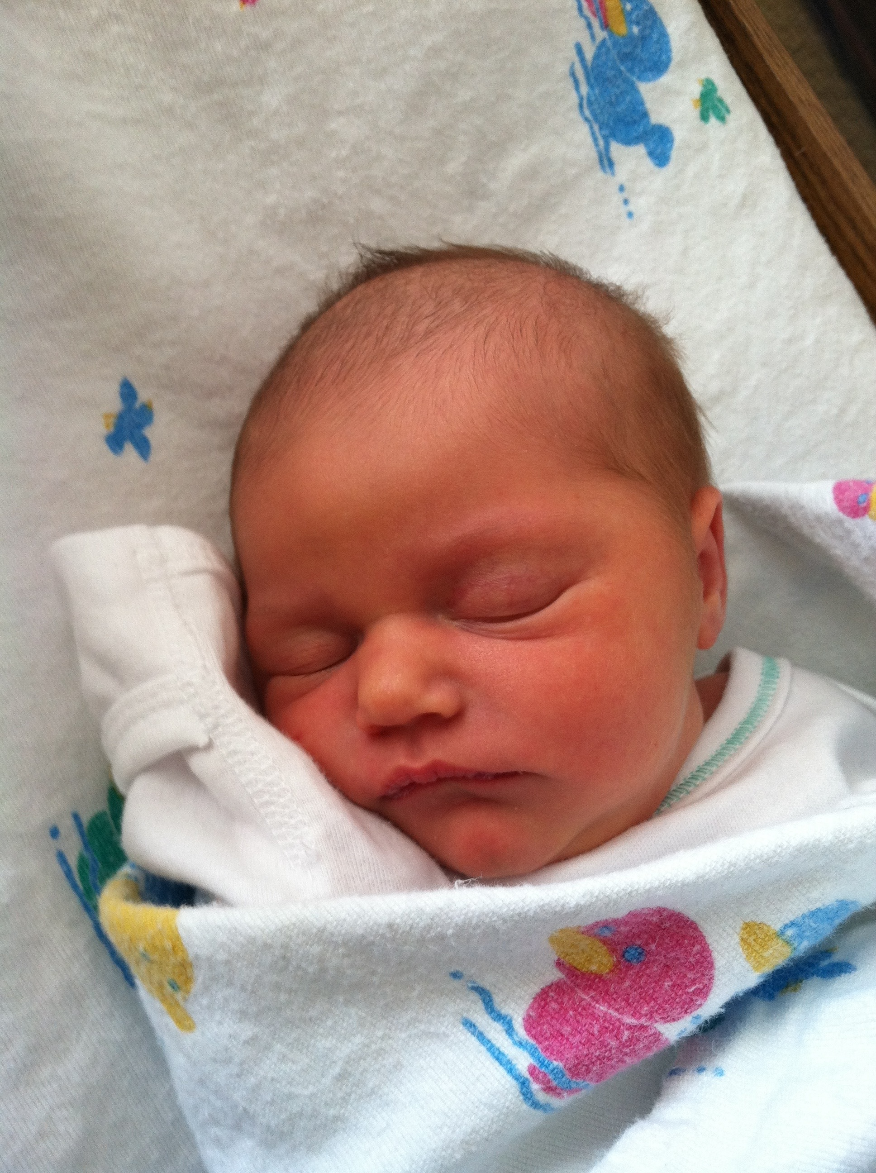
When & How is a Baby Baptized?
A person other than an Ordinary (priest) is allowed to confer a Baptism in the case of an emergency, necessity, like when a baby is about to die, and only those things required for validity are observed
3 Rituals
Sacrament of Penance
Sacrament of Baptism
Sacrament of Annointing the Sick
The hermetic sealing, a void is formed, the holy spirit fills the void, it is not the baby’s soul because it has been taken by the Ferryman to Moloch (Satan)
Midwives (nurses) are licensed under Ecclesiastical Law.
They have created a scenario whereby if a baby is claimed to be in imminent risk of death, a midwife or some other licensed people can perform the act of Baptism
Involves the salvage of the soul as the baby is claimed dead and has to be reborn through the ritual
The Birth Ritual
Mother in great pain, suffering represents the Sacrament of Penance
This makes the birth a remittance, a gift
The umbilical cord is cut, the baby is separated, becomes abandoned
The baby is cleaned, a ritual performed on the dead
Oil is wiped across the baby’s forehead, the anointment of last rites before death, a sealing
Water diluted with silver nitrate is used to wipe the baby’s eyes and mouth
Silver nitrate, all gold atoms removed, represents the ancient ritual of placing 3 coins on the dead
The coins pay the ferry man to salvage the souls across the River Styx

Slide 15


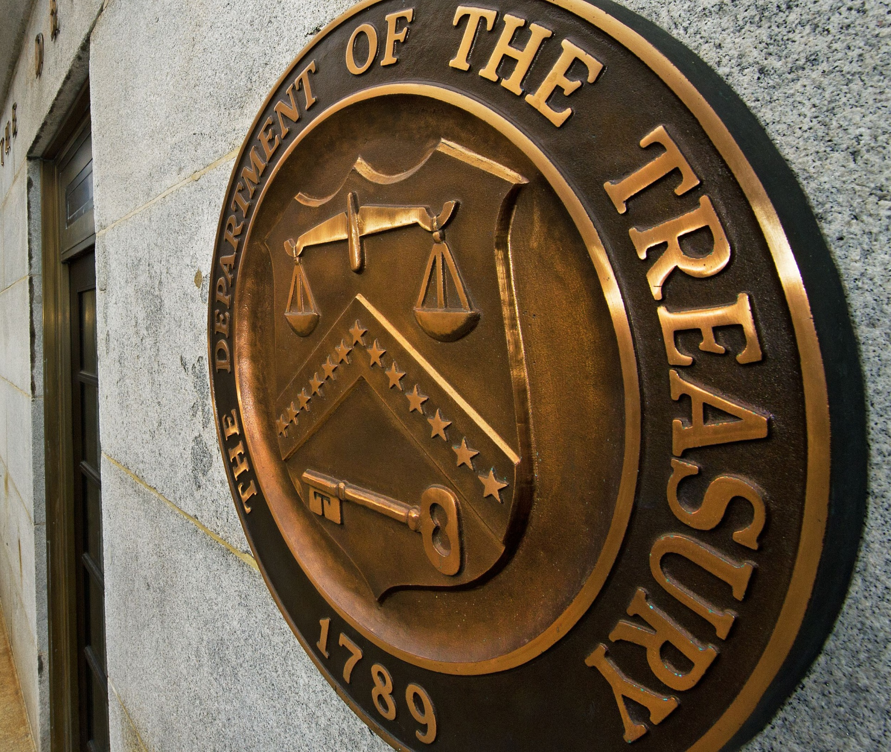
Baptism – What Is Going On?
The Indulgence are their Bonds, the receipt of goods and payment received by the Vatican for “salvaging souls”, and the right to control the monetization of Sin, essential for underpinning debt and almost all money systems today. Sin is a commercial Claim of Right dressed up as religious dogma
What is a Bank?
Ba: Soul (Egyptian)
Ankh: Symbol of Isis, Luciferia, Lucifer
Ba-Ankh (Bank):
Soul of Lucifer (Satan)
Ancient Death Ritual
The Egyptians placed 3 bronze coins on the body as practitioners of salvagers of souls.
The ferry man took those coins as a fee as he ferried the soul across the River Styx.
Embedded in treasure is the soul, the most valuable thing in their system.
What is Treasure?
Tre: 3, trinity
As: Bronze coins
Su: Close to
Re: Property
Treasure:
3 bronze coins on or near the property
Baptism creates 3 CQV Trusts enabling them to write Bonds of extraordinary value against the baby. A bond is a perfected indulgence. Private is the ritual, public is the bond, that’s the separation of Church and State. Every public ritual is the perfection of a private ritual. They cannot write a bond unless the ritual is performed

Slide 16
The Sacrament of
Penance

Slide 17
The Sacrament of Penance
A formal collection of rituals
formed by the Vatican
in the 12th C under Canon Law for the salvation, reconciliation monetization
and remittance of sin
in the form of indulgences, known as
Negotiable Instruments, after baptism.

Slide 18

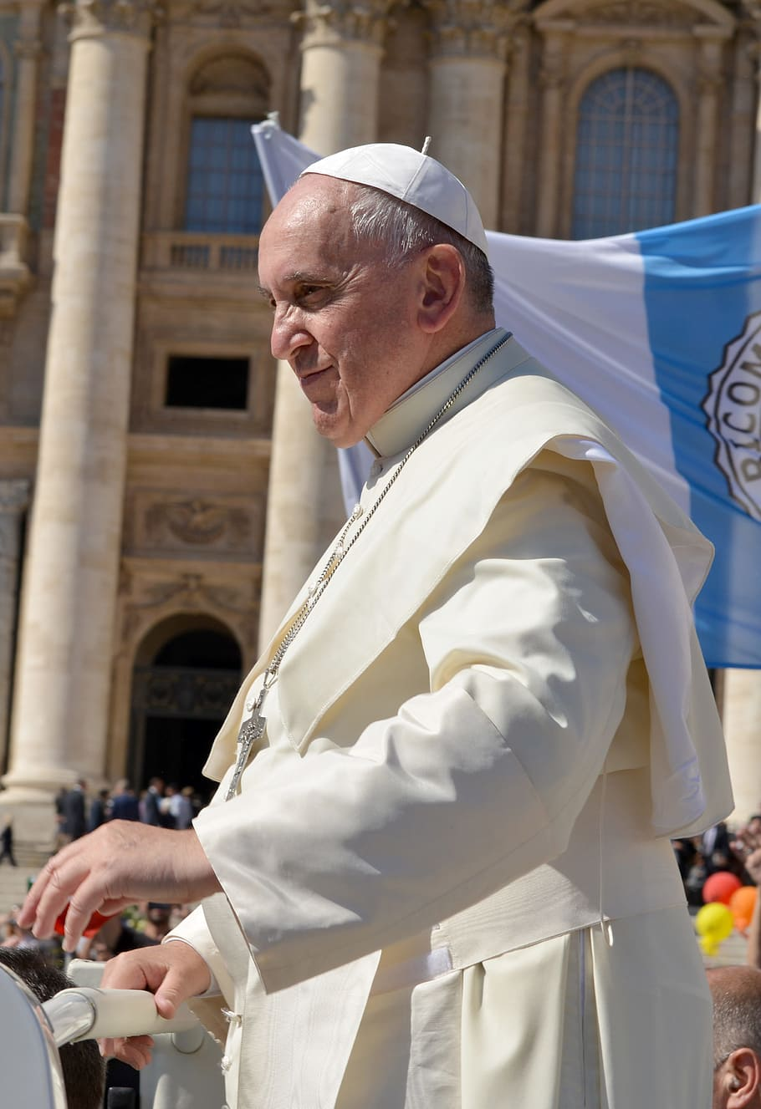
Penitus - Penitence
When Frankish knights restored law and order in Europe through the 8th C onwards, they promoted a Gnostic approach to Christianity and the concept of Penitus
Penitus
Meaning honest self-examination,
To look inside deeply, thoroughly
The twin concepts of self-examination of ones own faults and
Then the act of “purgo/purgare” to “cleanse, purify, purge, clear away”
By acts of deep prayer, meditation, self-deprivation, humility & charity
Penitence
From Latin Poenitentia meaning
“the tiara of the Roman Pontiff
now controls punishment”
In the 12th C the Vatican promoted the concept of Penance, which was no longer an act of self-learning,
knowledge and honesty, but an act of pain, punishment and subjugation controlled by the Pope

Slide 19
The Sacrament of Penance
The “unholy” Sacrament of Penance involves 3 parts
Contritio (contrition) is considered the willing repentance and remorse, free from fear or duress, before a minister called a “confessor” either as or on behalf of the “penitent”
Confession (confession) is the vocal confession by the confessant to the confessor of one or more sins, or crimes, free from fear or duress
Satisfactio (satisfaction) is the sentence issued by the confessor to the confessant who then must execute the sentence willingly. Once the sentence is uttered, the sin is completely separated from the confessant and “salvaged” by the confessor
A judicial process in which the penitent is at once the accuser,
the person accused, and the witness while the priest pronounces judgement and sentence.

Slide 20
Court

Slide 21
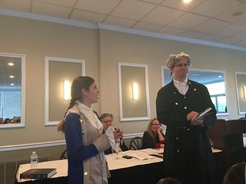
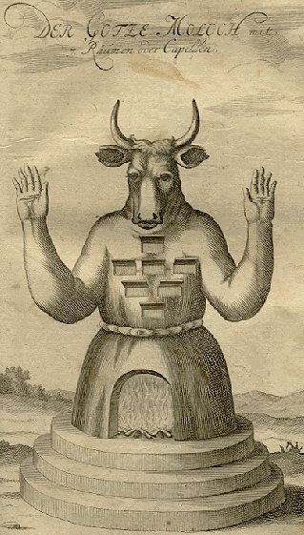
What is the BAR?
The BAR Guilds are private societies that use merchant trading principles to commercialize law and personally
profit from crime. Today, the BAR Guilds control almost 100% of judicial assemblies around the world.
The primary purpose of the Crown Temple & members of the BAR is to salvage souls through salvation
Origins:
Around 1,000 CE the city of UR was converted to the largest necropolis ever seen
“Galla” were the attendants of Erishkigal, Goddess of the Underworld
They wore black robes, were considered grim reapers, with the power to steal/consume souls if not placated
The HQ of the Galla was moved to Vatican Hill around 200BCE; hence, the Roman Pontiff has always been the High Priest of the Galla, and only claimed to become Christian in the 11th C
Ba’al/Ba’el = Master or Lord (Bar Bar = Lord Ba’al/Satan)
Baalism is an ancient fertility cult, known for being the most murderous cult known, engaging in sacrifice of the 1st born, ritual murder of children, cannibalism and the sacred ritual of holocaust (burned alive)
The god “G” of freemasonry (spiritual home is the Crown Temple/Temple Bar, London) is Ba’al
All judges, clerks, lawyers etc. of the Bar Societies and Associations knowingly or unknowingly, swear an oath to Ba’al (god = gad = saboath = satan = ba’al)

Slide 22

What is a Court?
The Carolongians created the Universal Catholic Church in 751
In 1057 GreGory VII became the 1st satanic anti-Pope as the wealthy Khazarian trading families of Venice, Genoa and Naples found new claims of right over Christianity
These families were also known as the Phoenicians…
The Medici family helped organize a system of guilds known as Arti.
One of the most powerful of these was the Arti de Guidici e Notai (Guild of Judges and Notaries)
Rather than being professors, philosophers and experts of law first, they were merchants first and their product was the commercialization of penalties – known as bonding, securities, and bailment
The place where these merchants plied their trade was called a “cautio”, what we now know as a court.
When these people saw how much money could be made from the commercialization of sin through the Guild of Judges and Notaries, they invested heavily in the Roman Catholic Church
By 1250 they had issued the 1st forgiveness in retirement of all sins and debts, or insurance against sin, indulgences
The BAR Guild and modern courts are the descendants of the Guilds of Judges and Notaries, maintaining the same model of commercialization of sin
Court from Latin “cautio”
A place of bonding, securitization and bailment of oaths/vows/cases

Slide 23
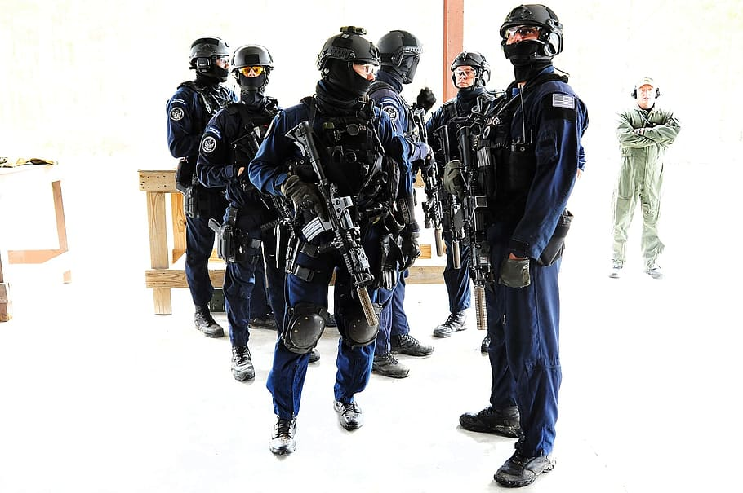


Corporate Securities – Instruments, Bonds, Bailments, Securities
Commercial Instruments are Instruments that are similar to the standards of Westminster and the Bank of England. from the 18th Century.
The B of E seized total control from the start of the 19th Century
Eventually it declared the subjects of the British Empire and the world, to be insolvent debtors
Subject to the complete control of the banks and their legal agents
Security
Security from Latin term ”secures” -“axe; or the force and death blow of an axe”; or “supreme power” and the derivative ”securitas”
Meaning “safety through power and force”
Or freedom from anxiety (through threat of power and force)
Thus Security is Surety of performance not through trust or honor but through their replacement by threat of power and fear of force. Security is therefore an absence of trust
Bond
A Bond is a formal Instrument issued under the Corporate Securities standards of instruments and writing first formed under the Westminster laws of Great Britain from the 18th Century
It is a form of obligation containing a penalty
A condition is annexed, either for payment of money or performance of covenants as
Security for performance against a Bill or Contract
Bail from Latin “baiulus” meaning
“coffin bearer, carrier of a burden”
From 15th C – a money bond
A Corporate Security is a formal Instrument that also represents a tradable asset that is underwritten by some form of Assurance or Insurance for the payment of any debt, or debit, or repayment, or demand, or loss connected to it.

Slide 24
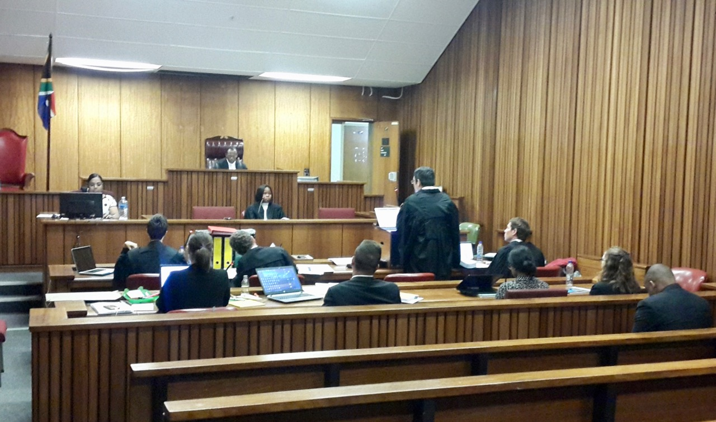
Criminal Courts – Courts of Penance
The courts in most Western nations operate as Penal Courts,
also known as Criminal Courts, also known as Courts of Penance
Contritio in a Roman Court is the pre-trial hearing or hearing at which the Indictment is read by the Prosecutor acting as the "confessant”
Confessio in a Roman Court is the trial or judgment phase during which the Prosecutor seeks to perfect the confession of the "penitent" with the assistance of agents who may convince the accused to "turn" such as an attorney
Satisfactio is the sentence issued by the confessor (judge) to the confessant who now becomes the penitent by consent and must execute the sentence willingly.
Private International Law, being pure commercial slave law, has corrupted and abrogated the sacrament of Penance before Roman Courts. Most jurisdictions no longer consider willing consent as a fundamental requirement to obtaining a fair conviction, nor the valid “salvaging” of sin as monetized debt in the form of a bond. Therefore, many sentences and bonds issued since 1933 are invalid.

Slide 25

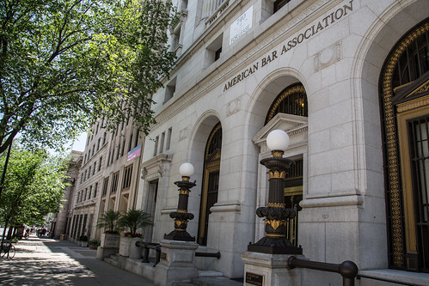
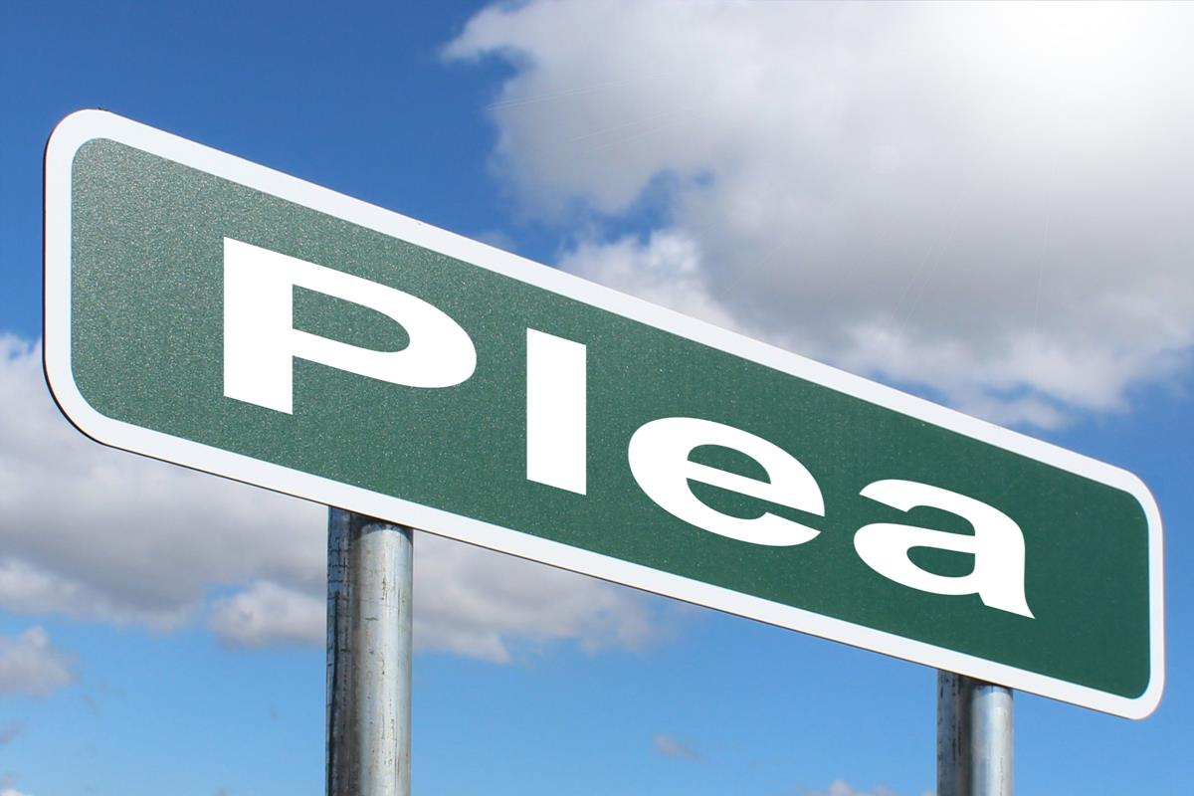
What is Guilt
Guilt is an an ancient commercial legal term associated with Private Guilds from the 13th C, meaning either payment made in gold or a debt or fine owed to the Guild. Guilt is not the same as innocence, which describes the complete absence of legal guilt.
The BAR Guild could lawfully detain as “surety” a non-Guild member who was Guilty and therefore, unable or unwilling to pay a debt or fine owed to the Guild.
The Guild could also issue a Guilt Bond against the flesh as surety, then sell it as a means of recovery of the debt owed to them
The word guilty originates from 14th C Dutch “gilde”, from the 13th C Italian “gilda” meaning “guild, payment in gold, debt or fine owed to the guild”.
Gilda came from 8th C Khazarian/Magyar “kulta” meaning “gold”
Guilty means “I will pay” and tacit consent of liability of a debt or fine owed to the Guild or the lawful detainment of the flesh until the debt or fine is paid.
Not guilty means “I refuse to pay” with the presumption of liability for the debt or fine owed, but a belligerent refusal to pay permitting the lawful detainment of the flesh as surety until the debt or fine is paid
Contrary to any claimed constitutional or conventional law that assumes innocence until proven guilty, the Private BAR Guild presumes the accused holds the formal position as Guiltee (Guilty) regardless of plea, unless the Guild rules not guilty at the end of a trial or summary-judgement hearing
A Private BAR Guild judge that forces an accused to plea Guilty or Not Guilty to the exclusion of other valid pleas, means that without valid consent of the accused, the judge accepts the debt and liability personally

Slide 26
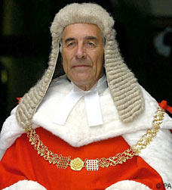
What is a Judge?
Judgement: (L) “iugo” meaning “to bind together, connect, couple (together) and “mentis” meaning “mind”
Judgement “means to bind together the mind and person”
In any controversy where a trust is formed in the name of a legal person, a judge holds the position of Executor by presumption only
The role of a Western Roman Court Judge is a purely commercial duty to their private BAR Guild, which is to bind the mind & flesh to a sentence, order, penalty through consent, thus making it “lawful”
A Judge sources their authority from:
1. As Executor or “Delegate” a judge has authority to execute orders and decisions
2. As Adjudicator, whereby all parties agree for the matter to be presided over by the Judge, a judge has the authority to provide their findings
Unless a Judge demonstrates an Oath before Parties to render fair justice prior to hearing the Suit, and unless both parties have given their consent, free of duress, then a man or woman claiming to be a judge holds no authority whatsoever to either hear the matter nor render justice on behalf of the law

Slide 27


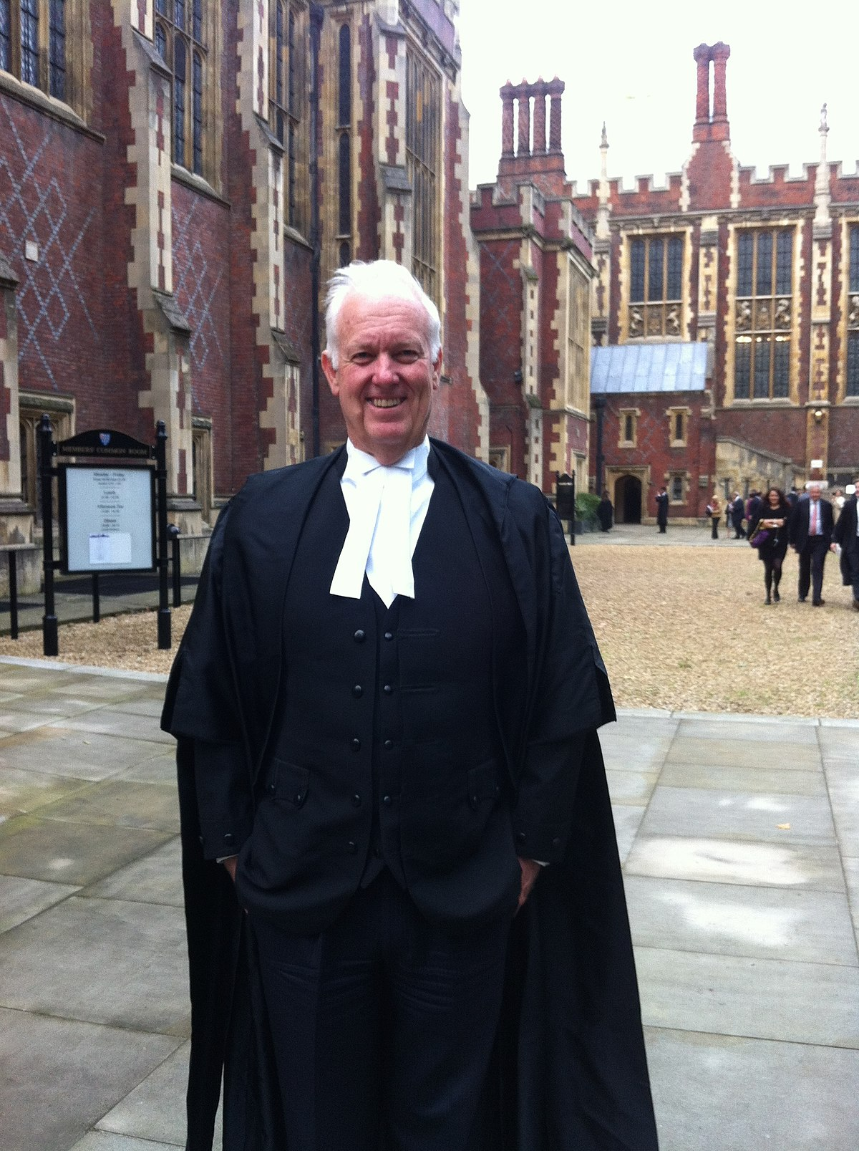
What is an Advocate/Counsel?
The Right to Counsel is a principle of Law, whereby all who are accused may seek the Counsel of an Advocate of their choosing to present their case before the court. Justice requires that the Counsel selected by an Accused swears a valid oath or execute a valid deed to truthfully serve the interests of the accused ahead of any other interests
Lawyer as Counsel
Attorney as Counsel
Barrister as Counsel
Lawyer is a 16th C word combining Latin words:
lar/lares: customary law
iuro/iurare: to swear, take can oath, to conspire
Hence, the original meaning is:
“one who has sworn an oath to customary law of the private BAR Guild”
Attorn or Attornment from 16th C combining Latin words:
at: to
torno: turn, round off, to consent to transfer of a right
Hence, the original meaning is
“a person to whom rights have been transferred by consent, implicitly or explicitly”
Barrister from 16th C combining Latin words:
baro: dunce, incompetent
sto/stare: to stand firm, to be in a position”
Hence, the original meaning is
“to stand/represent a dunce/incompetent”
A Lawyer, Attorney or Barrister are duty bound to to serve the interests of the private BAR Guild ahead of you; hence, they cannot possibly be an Advocate (Advocatio: “ad” = with + “vocare” = voice, “to assist in legal defence with one’s voice”

Slide 28

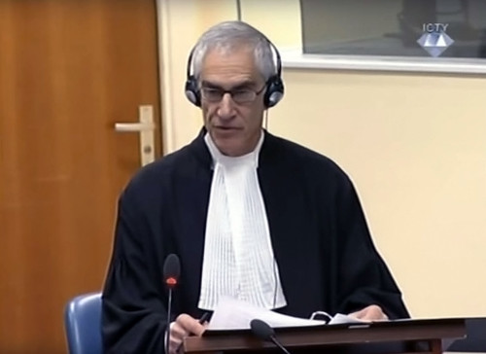

The Self-Confession – The Judge, Prosecution, Witness, Person Are You!!
Executor:
Ex Se: by reason of, through or in accordance
with himself, herself, or themselves
Cutis: skin, flesh
Ex+Se+Cutis means:
“one who speaks for himself, is their own commander & manager”
The Judge/Priest/Confessor
Prosecutor:
Pro Se: for one’s own behalf
Cutis: skin, flesh
Pro+Se+Cutis means:
“on behalf of one’s own skin and is a false beneficiary”
Authority of a Judge:
Holds the position of Executor by presumption only
The Witness
You are the living witness to your sin
The unnamed Beneficiary
Appointed Executor on sentence
Your mind bound to the fiction person
The Accussor
Makes the “self-accusation”
Representing the flesh of the accused
Appointed Beneficiary by the plea
Plea from ”pleais”, a prayer to Rome
The Accused/Confessant/Penitent
Fictional person,
Legally dead, a thing with no mind or will
A plea is a request by you the accused, to appoint the judge as Executor to hear your confession, create a formal contract
with the court and appoint the Prosecutor as Beneficiary

Slide 29
The 12 Key Presumptions
1. Presumption of Public Record:
Any matter for the Public Record is presumed by the members of the BAR Guild to be a private BAR Guild business matter
2. Presumption of Public Service:
Members of the BAR Guild have who have sworn a superior, solemn and secret oath to their own Guild are presumed to be acting as public agents of the government under public oath in contradiction to their private oath
3. Presumption of Public Oath:
Private BAR Guild members are presumed to be acting as “public officials” under public oath, bound to act honestly, impartially, and fairly, rather than private members of a Guild under a private oath
4. Presumption of Immunity:
Key members of the BAR Guild acting in their capacity as “public officials” are immune from personal claims of injury and liability and any personal accountability for their actions
5. Presumption of Summons:
An unrebutted summons stands; therefore, the one who attends court is presumed to accept a position and is under jurisdiction of the court by invitation of summons and the existence of “guilt” stands
6. Presumption of Custody:
An unrebutted summons stands; therefore, it is presumed the one attending court to be a thing and property, liable to be detained by custodians, who may only lawfully hold custody of property and things
7. Presumption of Court of Guardians:
You are listed as a “resident”, lunatic, of a ward of local government, have the letter “P” listed on your passport, are a pauper under the Guardian powers of the government and its Agents and must obey the rules of the clerk of guardians (clerk of a magistrates court)
8. Presumption of Court of Trustees:
You accept the office of trustee as a “public servant” and “government employee” just by appearing in the court
9. Presumption of Government as Executor and Beneficiary:
The judge is appointed Executor and the prosecution Beneficiary, making the accused the trustee by default,; therefore, must obey the rules of the Executor (judge)
10. Presumption of Executor De Son Tort:
If the accused exerts their right as Executor & Beneficiary over their body, mind, soul, they are acting as a “false executor” and the judge has the right to arrest, detain, fine or force the accused to have a psychiatric examination
11. Presumption of Incompetence:
The accused is ignorant of the law and unable to present themselves or argue properly; therefore, the judge has the right to detain arrest, fine or force a psychiatric examination, to do whatever they need to do to keep you obedient
12. Presumption of Guilt:
It is presumed to be a private business meeting of the BAR Guild; therefore, you are guilty whether you plead guilty, not guilty or do not plead. As such, the Guild can hold you until a Bond is prepared to guarantee the amount they want to profit from you
All presumptions stand unless rebutted. A summons can be rejected and returned, with a copy of the rejection filed prior to choosing to visit or attend, and a previously prepared affidavit of truth and motion to dismiss with extreme prejudice has been entered onto the public record. Presumptions can also be openly challenged and rebuked in court

